Slide 1

Division of Student Affairs
Invest in yourself by connecting with us

Slide 2
Co-Curricular Learning Domains
INTEGRATING THE CCLDs INTO YOUR DEPARTMENT, PROGRAMS, & SERVICES

Slide 3
During this workshop participants will
Evaluate the importance of a co-curricular learning framework for the Division of Student Affairs and for their department
Recognize the Co-Curricular Learning Domains and Dimensions that link directly to student learning within their department, programs, and services
Write student learning outcomes that reflect the Co-Curricular Learning Domains & Dimensions
Identify methods and tools to assess and measure student learning
Discuss how the Co-Curricular Learning framework can be integrated into their assessment plan
Build a plan and timeline for integrating the Co-Curricular Learning framework into their department, programs, and services

Slide 4
Agenda
Review the Co-Curricular Learning Domain Framework
Discuss benefits and challenges of the CCLD Framework
Review expectations for adoption and integration of the CCLDs
Define the CCLDs and apply them to your department, programs & services
Use the CCLDs to write student learning outcomes and determine criteria
Determine assessment methods and tools
Clarify goals
Create a plan

Slide 5

What is the Division of Student Affairs Co-Curricular Learning Framework?
Notes:
Take a moment to write down your own summary definition of what the Co-Curricular Learning Framework is
What are some insights you gained from watching this video?
What are some things you are thinking or feeling after watching the video?
YouTube video link: https://youtu.be/FSfEVKaSjkI

Slide 6
At Iowa State University, we believe that learning is an activity that happens anywhere and everywhere on campus. Further, we believe that the activities associated with the college experience, especially those that help emerging adults gain the cognitive and social skills necessary to be successful outside of college, should be rooted in a common set of definitions and goals.
In the Division of Student Affairs, we call these definitions and goals the Co-Curricular Learning Domains, or CCLDs. The five Co-Curricular Learning Domains, definitions, and related dimensions provide both a framework and a language for describing/defining the learning that occurs through the co-curricular programs and services offered in the Division of Student Affairs.

Slide 7
Turn to a Partner or Self-Reflection
Share a story about how you, your department, service or program directly helped a student learn and grow.
Notes:
Powerful stories and examples of student learning and growth just like yours are prevalent throughout the Division of Student Affairs!
How do we uncover those stories?
How do we measure student learning?
How do we share our story and demonstrate our impact?
How do we weave our story and data together and amplify it?
How do we rally around a common language to represent our work and impact on learning?
The Co-Curricular Learning framework offers a tool to support us in answering these questions

Slide 8





What are the benefits of the Co-Curricular Learning Framework for ISU Students?
What are the benefits of the Co-Curricular Learning Framework for Division of Student Affairs?
What challenges and concerns do you anticipate having about adopting and integrating the CCLDs into your department, programs, and services?
What are the benefits the Co-Curricular Learning Framework for you and your department?
  What are you excited about?
Notes:
Benefits for the Division of Student Affairs
Formally establish student learning as a priority for the Division of Student Affairs
Demonstrate the impact of student affairs on student learning
The Division of Student Affairs can share empirical evidence of our impact on student learning
Use a common language to amplify our impact
Tell our story and our students' story in the most compelling way possible
Unify our division under a framework that supports the mission of the VPSA and ISU
How do you see yourself overcoming those challenges and concerns??
This framework does not change what we do – it just adjusts how we talk about it - you are already leading learning within your work!

Slide 9
Goals for Division of Student Affairs Departments
Design, engage, assess, and report using the language of the domains and dimensions
Bolster assessment and evaluation to demonstrate our impact on student learning
Help students identify and reflect on the learning they are experiencing
Tell our story using the domains and dimensions
Notes:
Integrating the CCLDs within the division is a major priority for the coming year. Here are a few broad goals that frame up this priority.

Slide 10
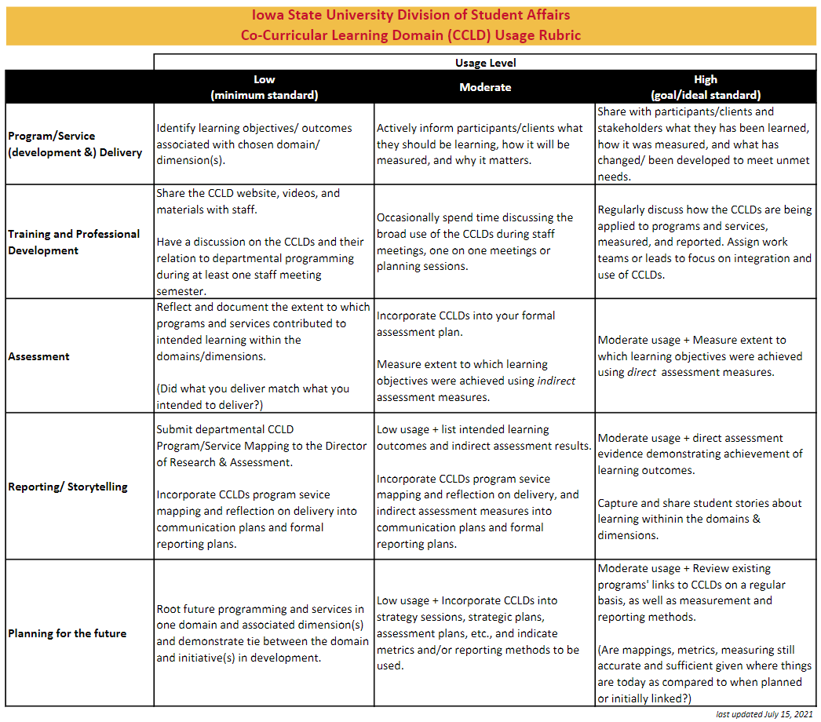
Notes:
This CCLD usage rubric provides an opportunity for departments to set goals for how to implement the CCLDs and to track progress on implementation. By the end of this workshop you will have made significant progress towards at least implementing the CCLDs to the minimum standard of “low”. We are here to support you along the way to help you progress to the ideal standard.
Have participants refer to the handout with this usage rubric. Let them read individually and then ask questions if they have any.
Share out: Choose one category and share what implementation level your department is at within that category
What will it take to move to the next level?

Slide 11
Notes:
This CCLD usage rubric provides an opportunity for departments to set goals for how to implement the CCLDs and to track progress on implementation. By the end of this workshop you will have made significant progress towards at least implementing the CCLDs to the minimum standard of “low”. We are here to support you along the way to help you progress to the ideal standard.
Have participants refer to the handout with this usage rubric. Let them read individually and then ask questions if they have any.
Share out: Choose one category and share what implementation level your department is at within that category
What will it take to move to the next level?

Slide 12
Notes:
This CCLD usage rubric provides an opportunity for departments to set goals for how to implement the CCLDs and to track progress on implementation. By the end of this workshop you will have made significant progress towards at least implementing the CCLDs to the minimum standard of “low”. We are here to support you along the way to help you progress to the ideal standard.
Have participants refer to the handout with this usage rubric. Let them read individually and then ask questions if they have any.
Share out: Choose one category and share what implementation level your department is at within that category
What will it take to move to the next level?

Slide 13





Think about your department. In your workbook, circle the domain that represents the learning students experience when they interact with your programs, services, and staff
Notes:
Provide opportunity for each participant to share the domain they chose and their rationale for why they chose the domain. There is not one right answer here. The conversation and sharing will help the team make meaning of the domains and begin to contextualize them within their department/work.
Instructions
Turn to page 5 of the workbook
Think about your department and the services and programs it provides. What are students learning?
Circle ONE domain on page 5 and provide rationale for why you chose that domain. Prepare to share out to the group.
You can complete this as a go’round so everyone is able to share. Create a visual representation of the rankings/votes for each domain on the whiteboard. Ask probing and clarification questions to help participants uncover their thinking.

Slide 14
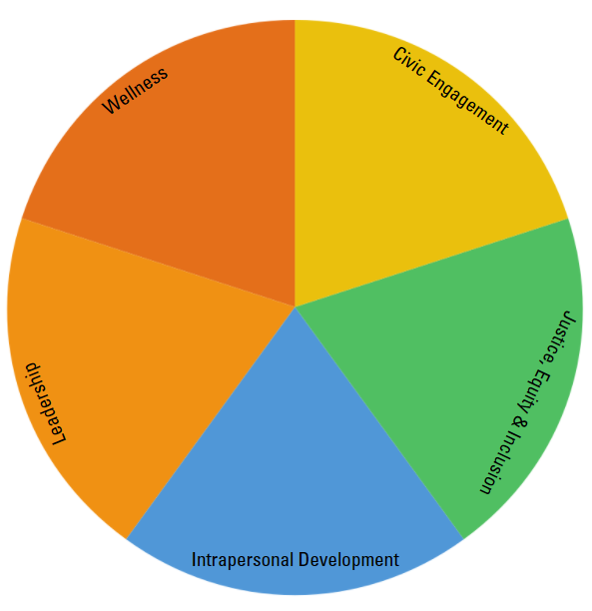
Now think about all of the programs and services offered by your department. Which domain most directly connects to each program or service? Be sure to ask yourself, what should students learn when they experience or participate in this service, program, or event?
Notes:
Be sure there is a list of signature programs/services from directors pre workshop
Hand out a copy of the CCLD 2-pager and encourage participants to thoroughly review both domain and dimension definitions (available in workbook)
Programs/services may map back to more than one domain, but try to limit mapping a single item to no more than two domains. Use the dimensions to guide and narrow thinking here.
Consider brainstorming/brain dumping all of the programs/services offered onto a whiteboard so all can view them. Then allow individuals to map on their own and then share out with the full group. Facilitator will write programs/services beneath domains on the whiteboard as participants share and the team has the conversation.
The goal is to come to consensus on which domain/s each program/service/event maps to and to ensure everyone has a chance to voice their opinion and rationale.

Slide 15
Student Success
Transition support for all students entering ISU
Course-based, residential and course-based and residential learning community options
Discipline-specific, thematic, interdisciplinary
Peer Mentor Program
University-Wide Professional Development, August professional development event, supplemental workshops
Peer Mentor survey to evaluate effectiveness of mentor support
Resources: Peer Mentor Handbook, Canvas resource, website, social media
Coordinator Professional Development
May Institute
Mid-Year Institute
Early Career Professional Development Series
Workshops, Teaching & Learning Circles
Committee work; topical work-groups
Resources: Assessment workbook, New Coordinator Handbook, Peer Mentor Supervisor Handbook, English Links Guidebook, website
LC Central Administrative Program
Administration of the paperwork: Request for Proposal documentation (annual funding request which details goals, objectives and intended outcomes for individual learning communities); Annual Report documentation (individual LC program evaluation which details met goals, assessment of outcomes met, intended changes for the next iteration of the individual LC, and use of funding allocation)
Assessment: retention reports; general LC survey; NSSE data; annual reports; assessment guides
Budget: allocations and budget amendments between departments and central office
Curriculum : Course seat reservation via Office of the Registrar; English Links
Focused efforts on ways to close the equity gap (i.e. critical mass of women in STEM courses, increased involvement of students of color, first-generation, Pell-eligible, and international student populations)
Resources: individual consultation, marketing both internal and external audience), website and social media
Advisory committee and oversight of committee structures
Notes:
Be sure there is a list of signature programs/services from directors pre workshop
Hand out a copy of the CCLD 2-pager and encourage participants to thoroughly review both domain and dimension definitions (available in workbook)
Programs/services may map back to more than one domain, but try to limit mapping a single item to no more than two domains. Use the dimensions to guide and narrow thinking here.
Consider brainstorming/brain dumping all of the programs/services offered onto a whiteboard so all can view them. Then allow individuals to map on their own and then share out with the full group. Facilitator will write programs/services beneath domains on the whiteboard as participants share and the team has the conversation.
The goal is to come to consensus on which domain/s each program/service/event maps to and to ensure everyone has a chance to voice their opinion and rationale.

Slide 16
Students who attend a meeting with an academic coach will be able to articulate their academic strengths and areas for growth.
Students who attend a meeting with an academic coach will be able to make choices to expand their knowledge and skills to help them achieve their academic goals.
Write a student learning outcome using the CCLDs
WHAT ARE LEARNING OUTCOMES?
Goals that describe “the knowledge, skills, attitudes, and habits of mind that students take with them from a learning experience” (Suskie, 2018, p. 75).
HOW DO I WRITE LEARNING OUTCOMES?
Students (who __________) will be able to __________.
Suskie, L. (2018). Assessing student learning: A common sense guide. John Wiley & Sons.
Notes:
Students learn something every time they interact with us. Our goal is to identify the essence of what they are learning by associating learning outcomes with programs and services. These learning outcomes should use the language of the domains and dimensions to help us amplify our division’s impact on student learning.
- Review the definition and structure of a learning outcome with participants
Ask participants to read the example learning outcomes on the slide and share which Domain and Dimension the outcomes are connected to. These outcomes were created for use with the Academic Success Center Academic Coaching Program.
Next, each participant will choose a program/service and write one learning outcome using language from one domain and dimension
Have them refer to the CCLD 2-pager as a resource
They can also refer to the learning outcomes verb list in their workbook
Instructions for LOC Writing:
Turn to page 8 in the workbook
Step 1 – choose a program/service
Step 2 – Choose one domain connected to the program/service
Step 3 – Choose one dimension within the domain connected to the program/service
Step 4 – Write a learning outcome for the program/service using the language of the chosen domain and dimension
After each individual has written an outcome have them pair up with another participant
Partners will share their learning outcome and provide feedback/make edits based on suggestions

Slide 17
Students who attend a meeting with an academic coach will be able to articulate their academic strengths and areas for growth.
Create Criteria
Criteria help us know when a learning outcome has been met by describing what meeting that outcome entails or looks like.
Student shared at least one academic strength during the conversation with the coach
Student shared at least one academic area for growth with the coach
Student created a SMART Goal focused on improving within an indicated area of growth
Notes:
Review the definition and purpose of criteria. Provide and discuss an example of criteria for a specific learning outcome
Provide time for partners to create 2 criteria for each of their outcomes. What does meeting the outcome look like or entail?

Slide 18
Service/Program: Academic Coaching Meetings
Domain: Intrapersonal Development
Dimension: Self-Awareness & Understanding
Students who attend a meeting with an academic coach will be able to articulate their academic strengths and areas for growth
Criteria 1
Criteria 2
Notes:
Each participant will write their learning outcome on the board. Try to group outcomes for the same service/program together/near each other:
Indicate the program/service
Indicate the connected domain
Indicate the connected dimension
Write the outcome
Indicate two criteria

Slide 19
“Student affairs staff members need to have more than programs, activities, and experiences they think would contribute to student learning. They need to have the empirical evidence to be confident that these programs, activities, and experiences actually do contribute to student learning.”
Schuh, J. H., & Gansemer-Topf, A. M. (2010). The role of student affairs in student learning assessment. NILOA Occasional Paper, 7, 1-14.
Notes:
Setting learning outcomes for your programs and services is the first step. The next step is collecting evidence to demonstrate whether or not students have reached the outcomes.
Consider asking the participants:
What is evidence/data?
What can evidence/data look like?
How can evidence/data be represented?
Help participants learn that data does not have to be just numbers and facts. Data can be stories, observations, etc. The important thing is that we collect evidence that can point to the learning that we have planned for students to experience.

Slide 20
Current assessment methods and tools
Notes:
We don’t have to reinvent the wheel to collect data. We want you to reflect on how you are already collecting data about the impact of your services and programs. What learning do you see happening? How are you currently collecting and sharing information about that learning?
Activity: complete a scan of what assessment methods and tools are already being used to assess student learning.
Assign small groups of 2-3 to a specific program/service listed on the board
Provide groups of 3-4 with green sticky notes. Ask them to write down assessment tools, strategies, methods, practices that are currently in place to measure student learning within that program/service
Ask the team if the methods on their sticky notes measures the learning indicated in the student learning outcomes that were created today for the program/service.
If yes, explain how.
If no, how could you adjust the current method/tool to measure if students reach the outcome?

Slide 21
New assessment methods and tools
Notes:
Activity: Provide opportunity for participants to brainstorm new/additional assessment methods and tools. Participants can review the handout of methods and tools provided.
Return to original small groups
Provide groups of 3-4 with blue sticky notes. Ask them to write down new/additional tools, strategies, methods, practices that could be implemented to measure student learning within that program/service
Ask the team to explain to the group how the methods on their sticky notes measures the learning indicated in the student learning outcomes that were created today for the program/service

Slide 22
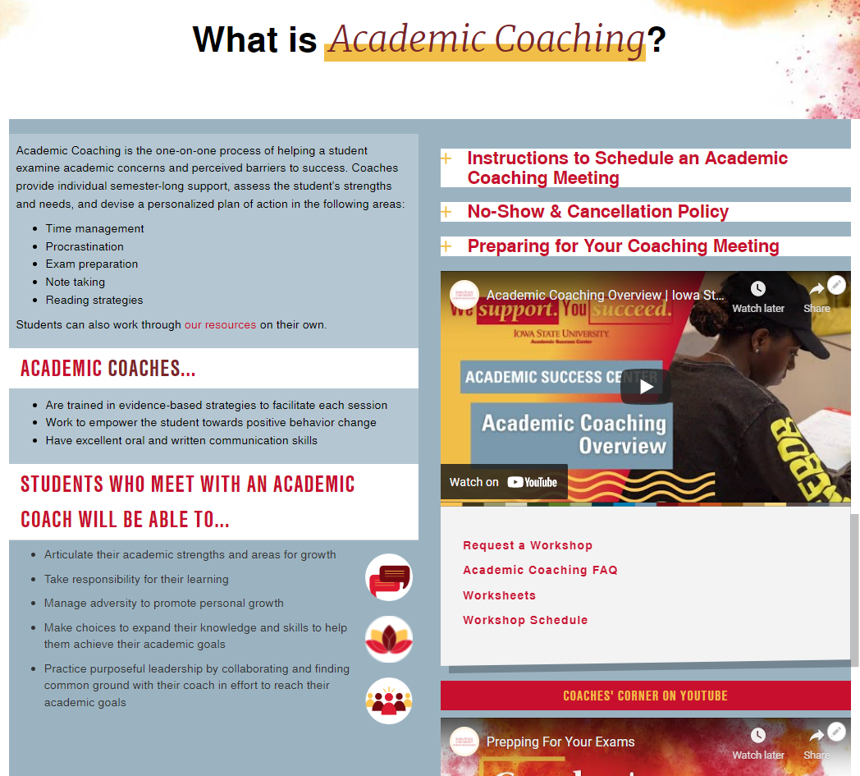
Publish your learning outcomes publicly.
Help students and stakeholders know what they
will learn when they interact with you.

Slide 23
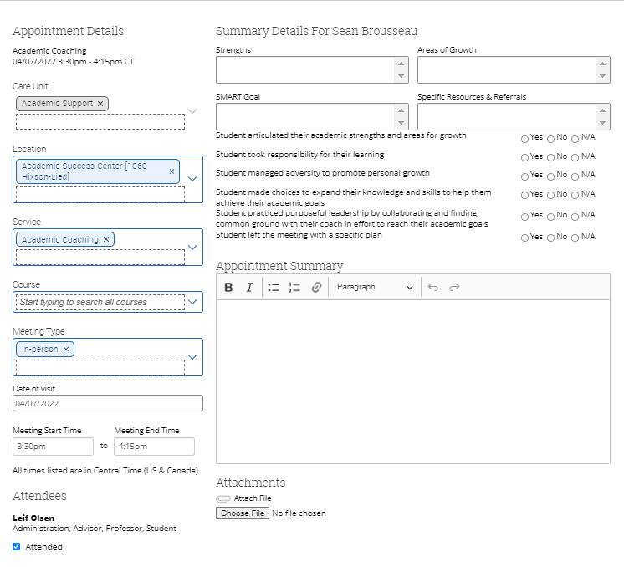
Align assessment with your outcomes. Choose methods and tools that will help you point to progress in or accomplishment of your stated learning outcomes.
Notes:
This is an example of how the academic coaching team is collecting evidence and assessing student learning within the outcomes we created using the domains and dimensions.
This data can be analyzed at any point, but more importantly the tool helps us train and support our academic coaches to focus on learning within the Co-Curricular framework while they interact with students.

Slide 24
Commit to a method/tool and envision the results
Circle one assessment method or tool you will commit to using to measure each student learning outcome
With your group discuss:
  What data, findings, and results can you envision collecting for this learning outcome using the selected method/tool?
  What ideas do you have for using and sharing the data?

Slide 25
Goals to work towards
By Fall 2022
Identify at least one learning outcome that integrates the CCLD framework for each of your department’s programs and services
Determine at least one specific assessment method or tool that will measure accomplishment of, or progress in each outcome
Design and implement the assessment method for each outcome
Collect, analyze, and use the data
Share your data, findings, and impact with us

Slide 26
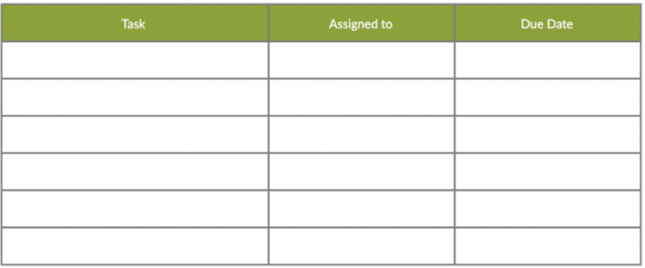
Identify at least one learning outcome that integrates the CCLD framework for each of your department’s programs and services
Determine at least one specific assessment method or tool that will measure accomplishment of or progress within each outcome
Design and implement the assessment method or tool for each outcome
Collect, analyze, and use the data
Share your data, findings, and impact with us
Create your plan to implement the CCLDs
Notes:
Today you had an opportunity to learn more about the CCLDs, connect them directly to your work using the language of the domains and dimensions, create learning outcomes using the framework, and determine possibilities for assessing those outcomes. We hope that this practice and application provides you with the information and confidence to continue to work towards full integration of the CCLDs in your departments and work. The final step is to create a detailed action plan that capitalizes on what you learned and practiced today.

Slide 27
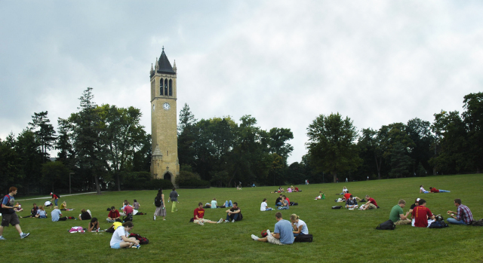
“We come to college not alone to prepare to make a living, but to learn to live a life” – M.J. Riggs, ISU Class of 1883
Unit or Department Name Here
Notes:
We hope that students will invest in themselves by connecting with us
The Co-Curricular Learning Framework helps us make the case that we are here to support students in their success at ISU, but also in life.
Hopefully this workshop has helped you become more confident in implementing the CCLDs within your department and work. Know we are here to help as you continue to work on this.
What questions can I answer before we wrap up?
If there is time consider a TTYP, Go’Round, or Write, Pair, Share
What is one thing you learned today and how will you use it to meet the goal of using the CCLDs in your work?

